Slide 1
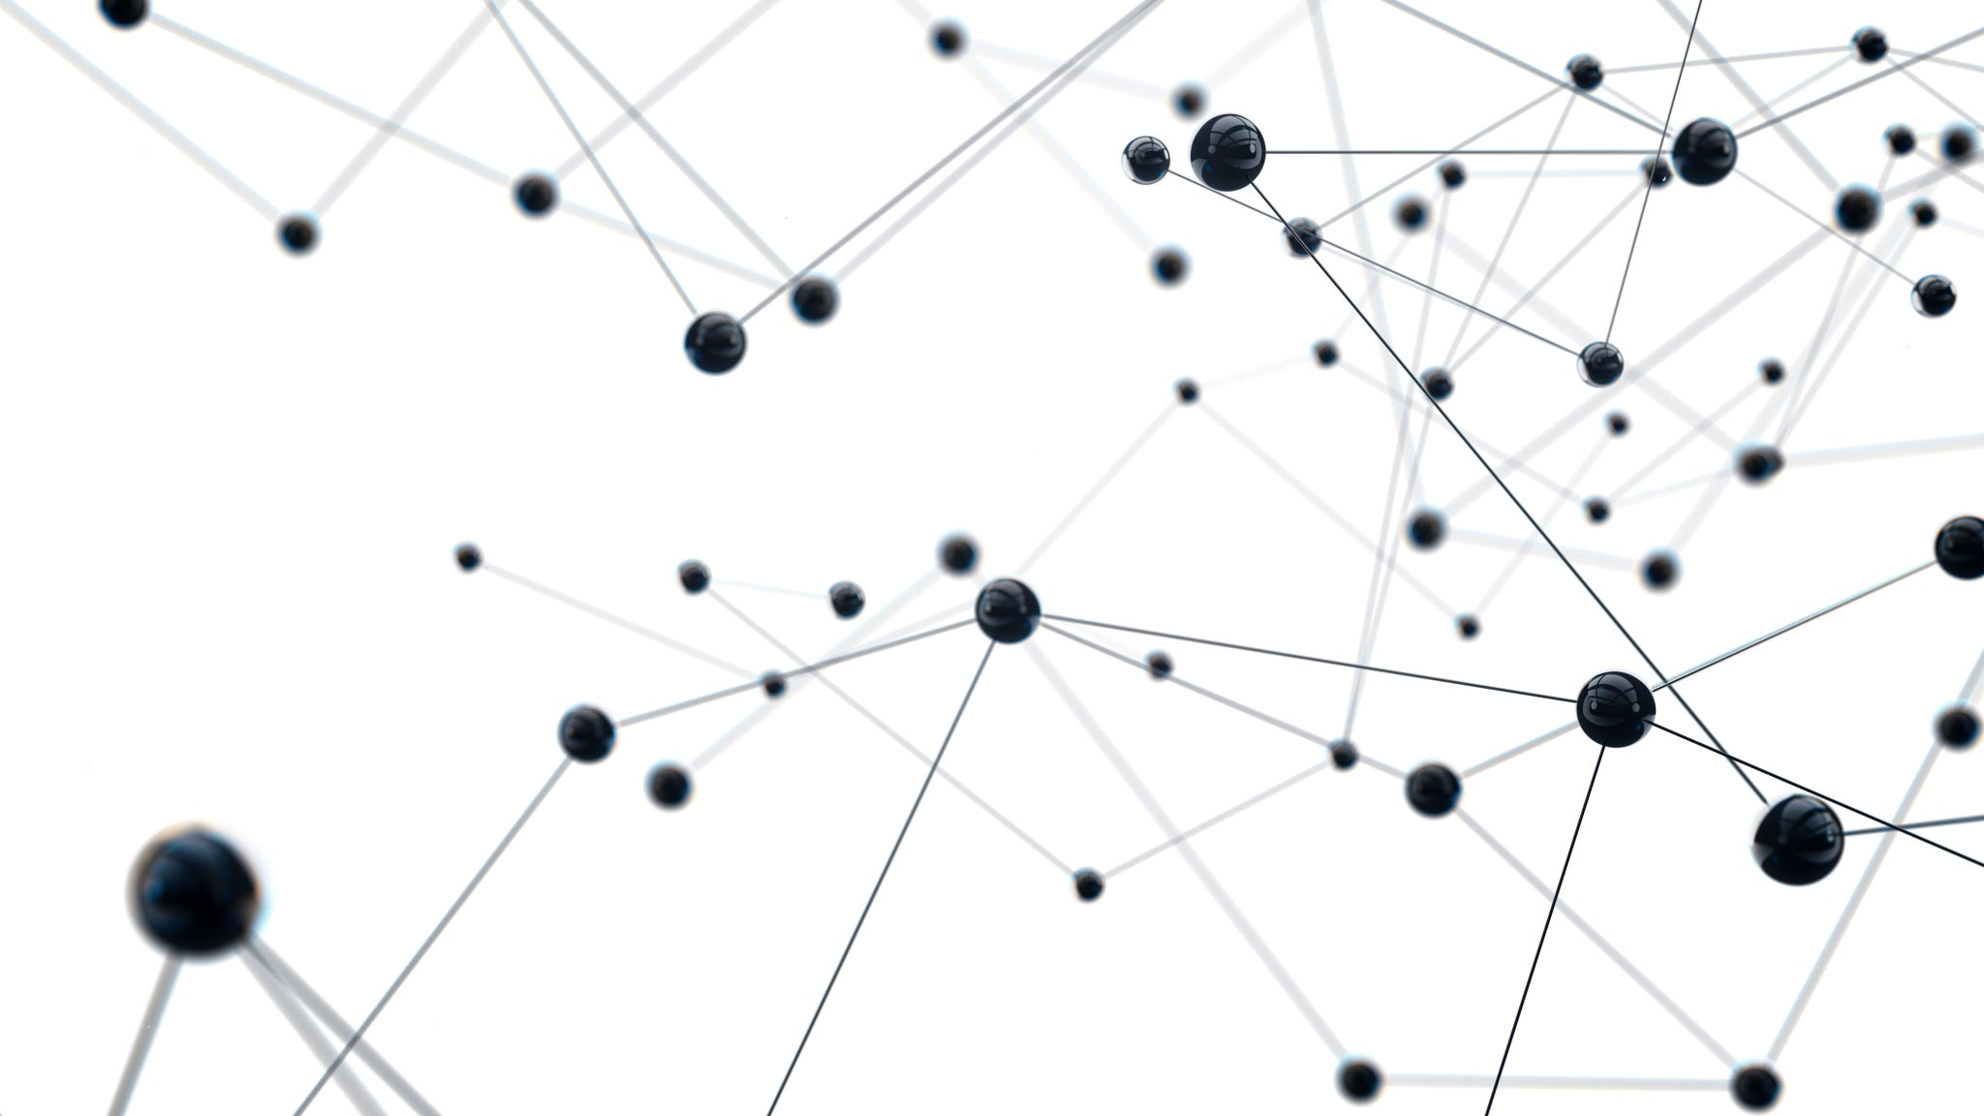
Development of machine learning models to process Electronic Health Records – Explainable Models
Week 12 Meeting, 13/1/2021

Slide 2
The week Before holiday
Tried implementing deep learning for classification
Rewatched the deep learning week 4 videos
Tried implementing the deep learning myself but resorted to the script codes at last (lost the visualisations due to version control mistakes)
Might be wise to focus on imputation strategies using deep learning instead of for inference?
Is there a point in using the deep learning models if my focus in on imputation now?
Started researching and looking into what imputation strategies to use and discuss

Slide 3
Imputation strategies
Mean/ Median imputation (Done)
Joint Imputation (Mean + Gaussian) (Done)
Most frequent (?)
KNN imputation
Multivariate Imputation by Chained Equation
Imputation Using Deep Learning

Slide 4
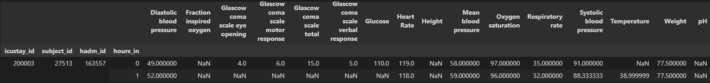


Problems with KNN imputation
Used the sk-learn KNNImputer class
Takes too long to run for entire dataset
Tried feeding first 100 row of data for testing given a shape of 100x16, returned a shape of 100x14
Original data
First row
Second row

Slide 5
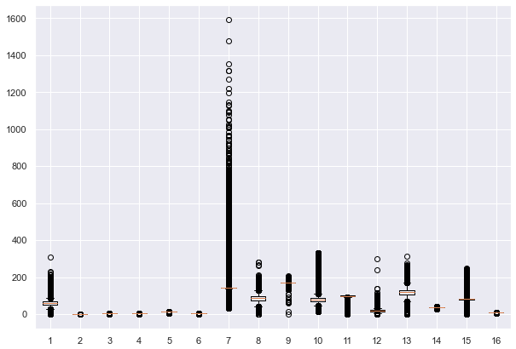
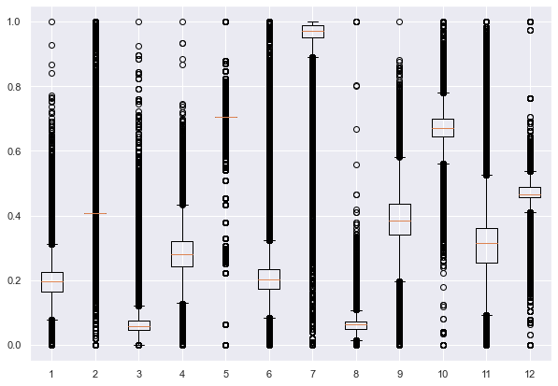
How to make box plots for large datasets?
Box plot of mean imputation results
Box plot of scaled data from notebook

Slide 6
My worries..
Found it challenging and time consuming to create code without relying on sources from the internet or from the notebooks
A lot of time wasted on trying to do an original implementation but couldn’t get it to work at the end
It was also extremely hard and time consuming to understand and use the example scripts without the basic knowledge of deep learning
It feels like I haven’t achieved much in the project (more like learning and studying about things I don’t know)
Not sure if I could write a good dissertation in time with my limited knowledge

